Slide 1

PHPTRAVELS TICKETS
Solving Common Problems with Smart Scalable Solutions

Slide 2

Problem Summary
Difficult to start from scratch (time & cost)
Market products are often outdated or low quality
Developers may not understand travel industry needs

Slide 3

Our Solution
Use modular, scalable architecture
Integrate reliable APIs (Flights, Hotels, Payments)
Follow agile process with domain-focused development
Prioritize user experience and reliability

Slide 4
User Management Features
Secure login/registration (Email, Social Login)
Role-based access: Customer, Agent, Admin
Profile editing, session management
Password recovery & optional 2FA

Slide 5

Hotel Booking Features
Search hotels with filters (location, price, rating)
Room availability, hotel images, amenities
Booking process with payment
Cancellation & refund management

Slide 6
Additional Booking Modules
Car Rentals:
Search, compare cars
Book and pay by duration
Tours & Activities:
Filter tours by location, type
Book and receive confirmation instantly

Slide 7
Payment System
Supports Credit Card, PayPal, Bank Transfer
Secure payment gateway integration
Invoice generation & error handling
Refund support

Slide 8
Admin Panel
Manage users & permissions
Control hotel, flight, car, and tour inventory
Dynamic pricing & discount rules
Generate reports: revenue, bookings, trends

Slide 9
Testing Strategy & Tools
Manual Testing
Test cases and scenarios are documented in Excel.
Used for functional testing of booking modules, user authentication, and admin workflows.
Helps ensure full coverage of business requirements.
Automated Testing
We use Selenium for UI automation testing (cross-browser and functional flows).
TestNG is used as a testing framework for:
Managing test cases
Grouping and prioritizing tests
Generating test reports
Automated scripts are maintained for:
Hotel and flight bookings
Payment flows
User login and registration
Benefits
Early bug detection
Faster regression testing
Better coverage and reduced manual effort

Slide 10
System Integration & APIs
Hotel API (availability, pricing)
Flight API (search, book, cancel)
Booking API (create, modify, cancel)
Full API test coverage

Slide 11
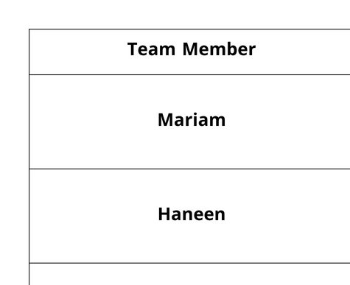
Team Roles & Responsibilities

Slide 12
Conclusion
Extensive manual and automated testing was conducted to ensure:
High performance and reliability
User-friendly booking experiences
Secure transactions across all modules
With tools like Excel for manual test and Selenium + TestNG for automation, we’ve ensured:
Full test coverage
Faster release cycles
Confidence in system stability
The platform is now ready for real users with strong foundations in quality, scalability, and usability.

Slide 13
THANK YOU

